Slide 1
From Matching to Generation: A Survey on Generative Information Retrieval (GenIR)
XIAOXI LI and JIAJIE JIN, Renmin University of China, China
YUJIA ZHOU, Tsinghua University, China
YUYAO ZHANG and PEITIAN ZHANG, Renmin University of China, China
YUTAO ZHU and ZHICHENG DOU∗, Renmin University of China, China

Slide 2
Table of contents
01
02
03
04
05
Introduction
Methods
Experiments
You can describe the topic of the section here
You can describe the topic of the section here
You can describe the topic of the section here
Discussion
Conclusion
You can describe the topic of the section here
You can describe the topic of the section here

Slide 3
Introduction
01

Slide 4
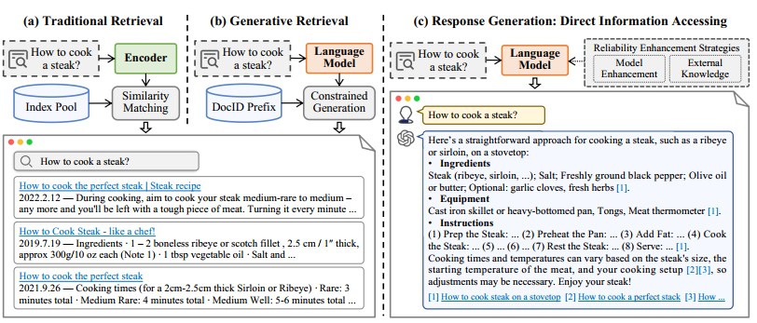
The Evolution of Information Retrieval
The Old Way (Matching):
Sparse Retrieval: Keyword matching (e.g., TF-IDF, BM25). Fast but lacks understanding.
Dense Retrieval: Vector matching (e.g., BERT). Better semantic understanding but relies on a massive external index.
The New Way (Generative IR):
Generative Retrieval (GR): The model is the index. It memorizes documents and generates their IDs.
Response Generation: The model generates a direct, reliable answer with citations.

Slide 5
Limitations of Traditional IR
Storage Overhead
User Intent
Manual Effort
Traditional Information Retrieval relies heavily on large document indices, leading to significant storage overhead that complicates data management and increases operational costs for organizations.
Capturing the nuanced user intent remains a challenge, as traditional methods often fail to understand the context of queries, resulting in less relevant search results and user dissatisfaction.
Users frequently engage in manual effort to interpret and summarize retrieved documents, which can be time-consuming and inefficient, detracting from the overall effectiveness of information retrieval systems.

Slide 6
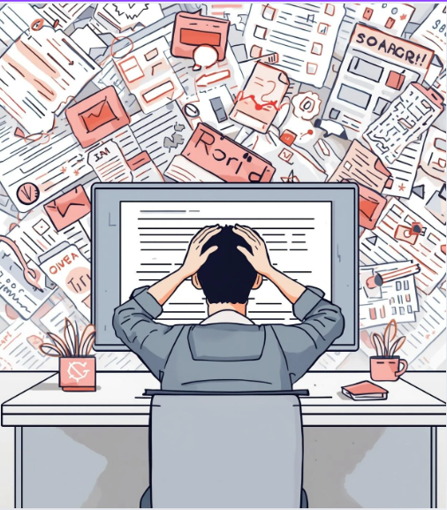
Traditional Retrieval vs User Struggle
Traditional retrieval systems focus on matching and ranking documents, not on answering user questions directly.
Users are often presented with a large number of loosely relevant results, increasing cognitive load.
Finding the correct information requires manual scanning, reading, and comparison across multiple documents.
Important details may be scattered across different sources, forcing users to synthesize information themselves.
The retrieval process is time-consuming and inefficient, especially for complex or specific queries.
Users experience frustration, information overload, and reduced search effectiveness.

Slide 7
Methods
02
Generative Document Retrieval
Reliable Response Generation

Slide 8
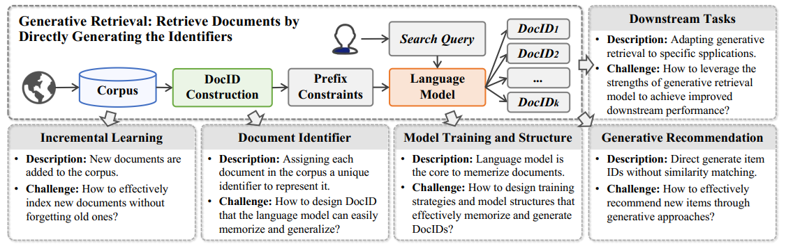
Generative Document Retrieval (GR)
Core Concept: The model is the index. It "memorizes" documents during training.
The Process: Query → Model → Document Identifier (DocID).
Inference: Uses Constrained Beam Search to ensure the generated ID corresponds to a real document³.
Advantage: End-to-end optimization; no need for a separate, massive external index.

Slide 9
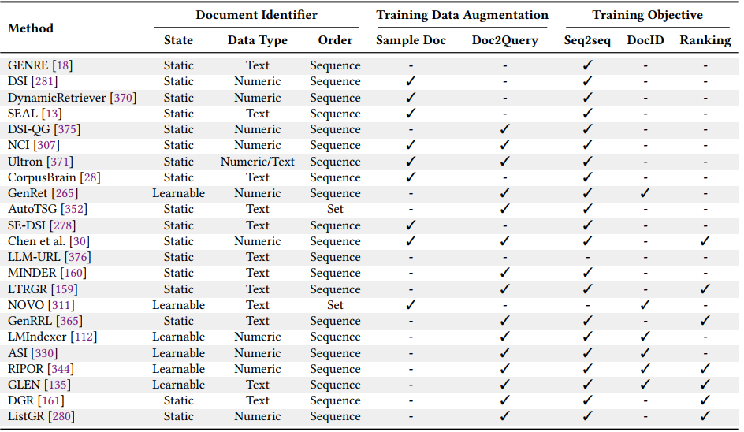
Designing Document Identifiers (DocIDs)
Numeric-based IDs (Structure):
Atomic: Random numbers. Hard to learn.
Semantic Clusters (e.g., DSI): Documents are clustered (e.g., by topic). Similar docs get similar IDs (e.g., 1-2-3).
Product Quantization (e.g., Ultron, MEVI): Compresses document vectors into short, discrete codes, preserving dense semantic information in the ID itself.
Text-based IDs (Semantics):
Titles (e.g., GENRE): Uses the document title. Easy for LLMs to learn because it has meaning.
Term Sets (e.g., TSGen, NOVO): Represents a document as a set of distinct keywords (e.g., { "Apple", "Recipe", "Pie" }). It removes the burden of predicting a specific order.
Sub-strings (e.g., SEAL): Uses any unique N-gram found in the text, identified via an FM-Index, allowing for flexible retrieval.

Slide 10
Training Strategies & Incremental Learning
Advanced Training Strategies:
Data Augmentation (The "Doc2Query" Trick): We lack user queries for most documents. We use a separate model to read documents and generate millions of "synthetic" queries. The retriever then trains on (Synthetic Query, DocID) pairs to ensure full corpus coverage.
Ranking Optimization: Standard language models only learn to predict the correct token. Models like LTRGR and DGR introduce Ranking Loss (e.g., RankNet), teaching the model to differentiate between "relevant" and "highly relevant" IDs, optimizing the order of the final list.
The "New Data" Problem (Incremental Learning): When a neural network learns a new document, it often overwrites the weights used for old documents.
Solution 1 - Constrained Optimization (IncDSI): Mathematically constrains the model updates so that the loss on old data does not increase while learning new data.
Solution 2 - Adapter Modules (CorpusBrain++): Keeps the massive "backbone" model frozen and trains tiny, lightweight "Adapter Layers" to memorize new information. This is computationally cheap and prevents forgetting.
Solution 3 - Incremental Product Quantization (CLEVER): Updates the quantization codebook dynamically to accommodate new semantic clusters without retraining.

Slide 11
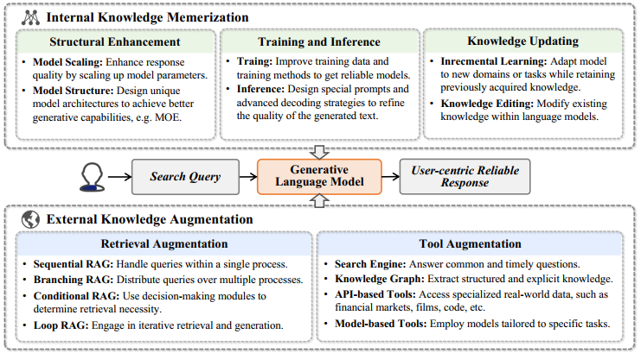
B. Reliable Response Generation
The Goal: We want an AI that acts like a search engine, giving answers that are not just fluent, but true.
The Challenge: Standard LLMs suffer from "Hallucination." They are like students who try to answer every question from memory, even when they don't know the answer. They prioritize probability (what word sounds good next) over truth (what is factually correct).

Slide 12
Strategies for Reliable Response Generation
Optimize Internal Knowledge (The "Brain")
Instruction Tuning: Training models to admit ignorance ("I don't know") rather than guessing.
Decoding Strategies (e.g., DoLa): Contrasting early vs. late neural layers during generation to mathematically amplify factual signals and suppress hallucinations.
Knowledge Editing (e.g., ROME): Surgically modifying specific model weights to update facts without expensive full re-training.
Augment with External Knowledge (The "Tools")
Active RAG (e.g., FLARE): The model monitors its own confidence. If low, it pauses generation, searches Google dynamically, and then resumes writing.
Tool Learning (e.g., Toolformer): The model teaches itself to call APIs (Calculators, Calendars, Code Interpreters) when text prediction is insufficient.
Enforce Verification (The "Proof")
In-Process Citation: Training the model to generate [Source: 1] markers while writing.
Post-Hoc Verification (e.g., RARR): A separate "Editor" model reviews the generated draft, searches for evidence, removes unsupported claims, and inserts citations retroactively.

Slide 13
03
Experiments
03
03

Slide 14
Evaluation Metrics
For Finding Documents (Generative Retrieval):
Recall@k: Percentage of relevant documents found in the top k results.
MRR (Mean Reciprocal Rank): How high up the list is the first correct result?.
nDCG: Measures ranking quality; rewards correct results appearing earlier.
For Generating Answers (Response Generation):
Rule-Based:
BLEU / ROUGE: Measures word overlap with reference answers.
Exact Match (EM): Used for short, precise answers.
Model-Based (Advanced):
FActScore: Decomposes answers into atomic facts to verify truthfulness.
BERTScore: Checks semantic meaning rather than just keywords.
Human Evaluation: Accuracy, Relevance, Fluency, and Safety .

Slide 15
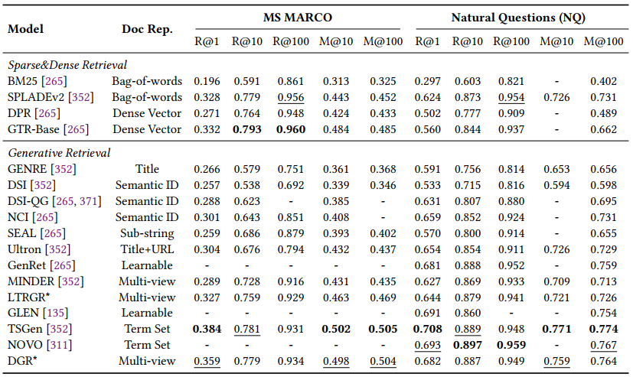
Experimental Results - GR Performance
Comparison: GR models vs. Dense Retrieval (DPR) vs. Sparse (BM25).
Key Result 1 (Small Corpus): On Natural Questions (NQ), GR models like TSGen achieve Recall@1 of 70.8%, vastly outperforming Dense Retrieval (50.2%).
Key Result 2 (Large Corpus): On MS MARCO (8.8M docs), GR models struggle to memorize everything. Scale is a major bottleneck.
Best Methods: Term-Set and Multi-View identifiers (combining titles + keywords) perform best.

Slide 16
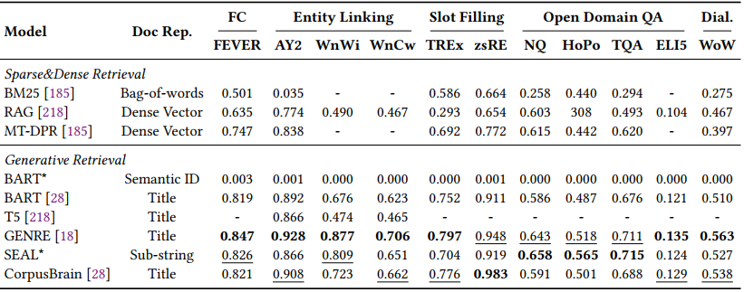
Experimental Results - KILT Benchmark
KILT: A massive Wikipedia-based benchmark (5.9M documents).
Winner: GENRE (Title-based).
Score: 0.847 on FEVER (Fact Checking).
Reason: Wikipedia titles are unique and semantic, making them easy for LLMs to generate.
Failure Case: Numeric IDs (like DSI) score near 0.0. Because models cannot memorize 5.9 million random numbers without semantic meaning.

Slide 17
03
Discussion
04
03

Slide 18
Key Challenges
Scalability
Dynamic Updates
Memorizing the entire web is impossible for GR models; they replace cheap storage with costly RAM.
Instantaneously adding new knowledge without full retraining remains difficult.
Inference Latency
Trust & Safety
Generating a DocID token-by-token is slower than a simple database lookup.
Hallucination and Bias remain the primary blockers for enterprise adoption.

Slide 19
Future Directions
Integrated Systems
01
Future research should focus on creating integrated systems that seamlessly combine Generative Document Retrieval and Reliable Response Generation for improved user interaction and efficiency.
02
Enhanced User Experience
Developing user-centric designs is essential for ensuring that the information retrieval process is intuitive, allowing users to easily navigate through generated content and responses.
Addressing Challenges
03
Ongoing efforts must tackle challenges such as scalability and accuracy to ensure generative models are reliable, efficient, and can be applied effectively across various domains.

Slide 20
03
Conclusion
05
03
From Matching to Generation, We are witnessing the fundamental evolution of search. We are moving away from systems that simply match keywords against a database and toward intelligent agents that generate knowledge.
Generative Retrieval: The model is the index.
Reliable Response: The answer is verified, not just retrieved.
The future is not a pipeline of separate tools, but a Unified End-to-End Framework. We envision a single AI model that can index the web, retrieve evidence, and generate trustworthy, cited answers in one seamless process.

Slide 21
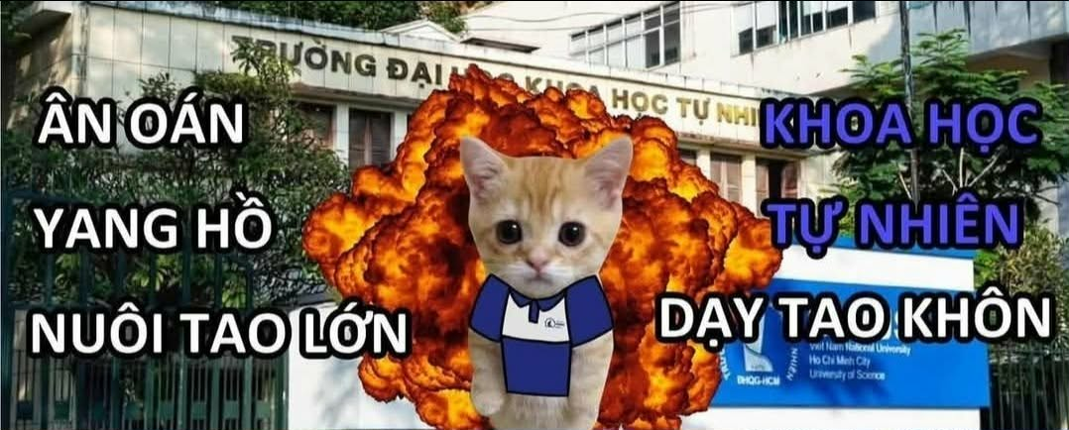

Meme Retrieval
Lê Hoàng Ân, Hoàng Tuấn Khoa, Trần Đức An, Đỗ Phan Tuấn Phát

Slide 22
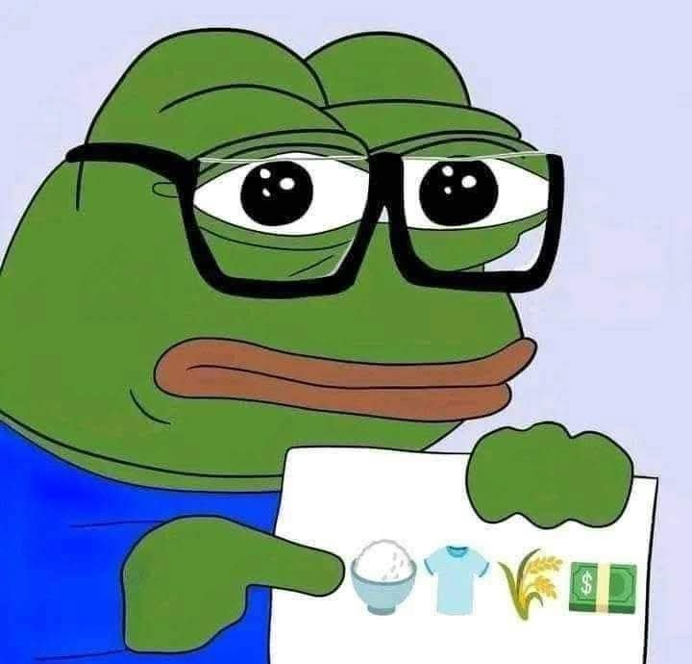
What we will present
01
02
03
04
The goal of the app
Practical use case and intuition
General strategies
General implementation

Slide 23
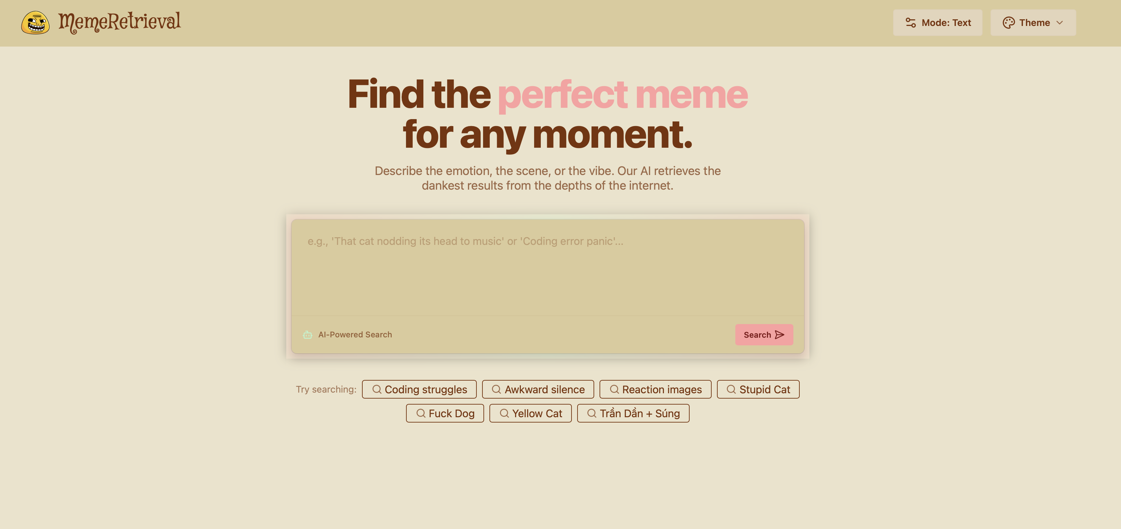
01
Goal
We want to build an app that lets people find memes (using retrieval techniques of course)

Slide 24
Use case and user intuition
02
How users want to search for that specific memes.

Slide 25


They may input some text or paste an image
1. They may search for captions or describe the meme
2. They may paste a picture of a character in the meme
“Peter Griffin racist meme”
“Peter Griffin ok not ok”

Slide 26
03
General strategies
03
How we solve the retrieval problem

Slide 27





EVEN AT THE AGE OF SEVEN HE THOUGHT LIKE A TERRORIST
MEME OF CUTE ITACHI RAISING HIS HAND

Slide 28

EVEN AT THE AGE OF SEVEN HE THOUGHT LIKE A TERRORIST
Elastic Search
Text search database
We will use elastic search to find similar meme captions

Slide 29


MEME OF CUTE ITACHI RAISING HIS HAND
Vector Database for Embeddings
Vector search database
We will process and embed the query, then search for memes matching description
Text removed
“MEME OF A CUTE PERSON RAISING HIS/HER HAND”

Slide 30


FACE SEARCH
Vector Database for Embeddings
Chroma database
We use chroma (FAISS) to search for memes that contain similar faces.

Slide 31
03
Implementation
04
03
Technical implementation

Slide 32
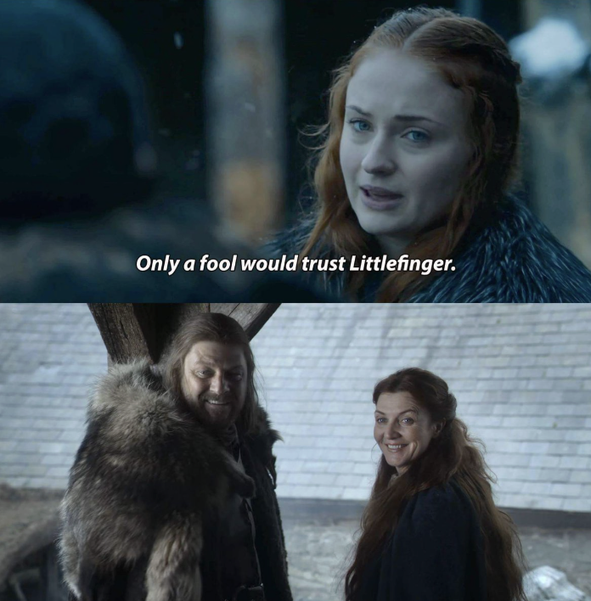




Use case 1: Text search
“A two-panel meme featuring characters from Game of Thrones.
Top panel: Sansa Stark looking serious, with text saying "Only a fool would trust Littlefinger."
Bottom panel: Ned Stark and Catelyn Stark standing together, smiling broadly and looking at each other.”
GliNER
Qwen2.5-1.5B-Instruct
Sansa Stark – Sophie Turner
Ned Stark - Sean Bean
Catelyn Stark - Michelle Fairley
WIKIDATA.ORG

Slide 33

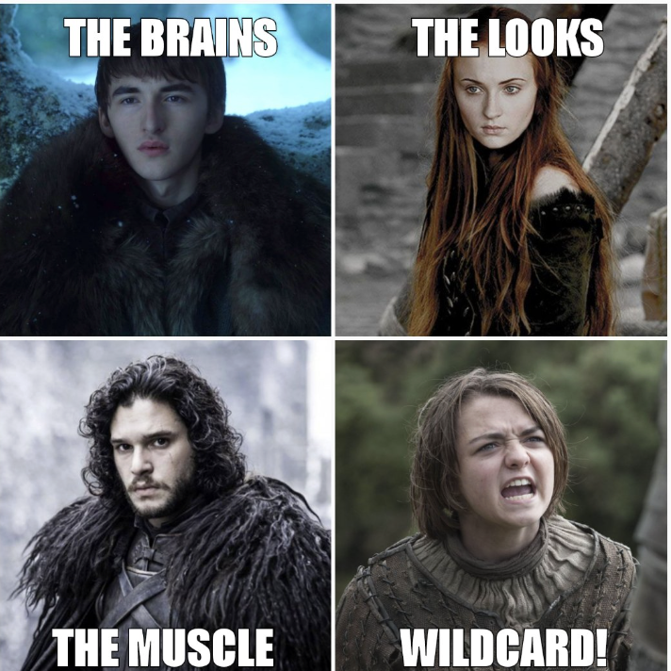



Use case 1: Text search
GliNER
Qwen2.5-1.5B-Instruct
Sansa Stark – Sophie Turner
Ned Stark - Sean Bean
Catelyn Stark - Michelle Fairley
WIKIDATA.ORG
Get face images of those celebrities (postgres+elastic search)
Chroma database (memes containing extracted faces)
ml-mobileclip

Slide 34



Use case 1: Text search
Qwen2.5-1.5B-Instruct
Prompting*
caption: Only a fool would trust Littlefinger."
descriptive text: A person looking serious, with text saying \"Only a fool would trust Littlefinger.\" A person standing together, smiling broadly and looking at each other.

Slide 35

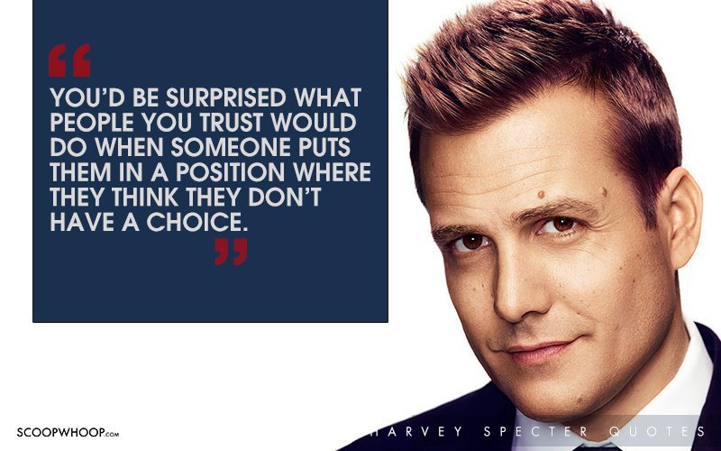



Use case 1: Text search
caption: Only a fool would trust Littlefinger."
Elastic search database (memes containing those captions)

Slide 36
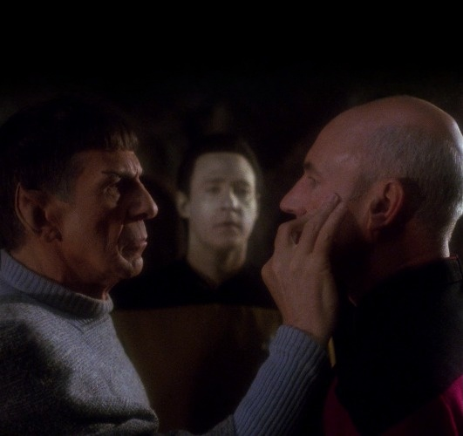
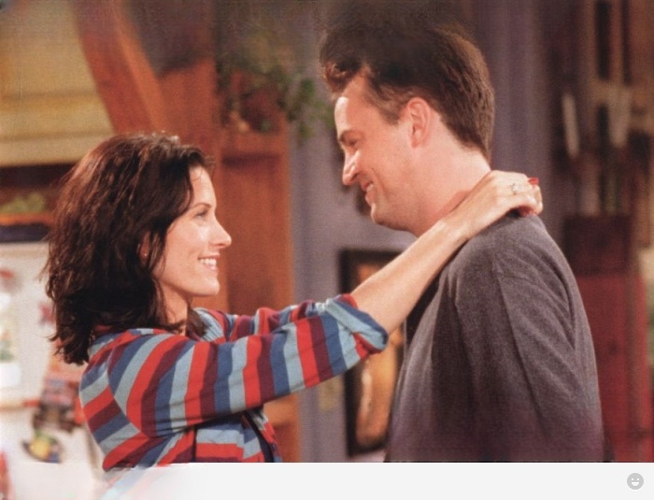
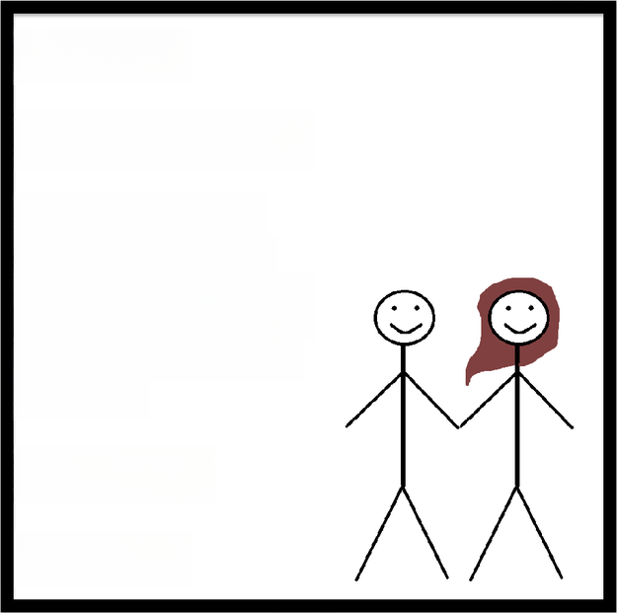
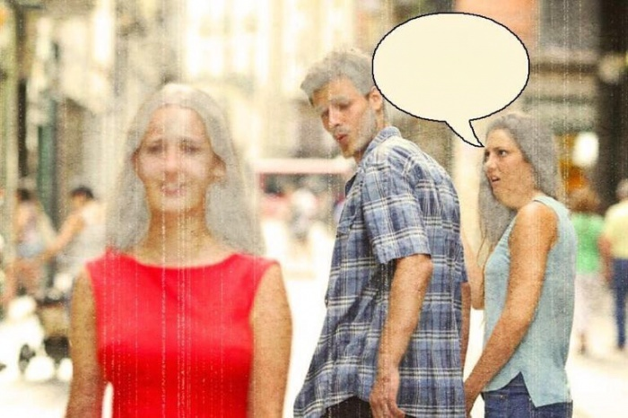

Use case 1: Text search
descriptive text: A person looking serious, with text saying \"Only a fool would trust .\" A person standing together, smiling broadly and looking at each other.
ml-mobileclip
weaviate

Slide 37
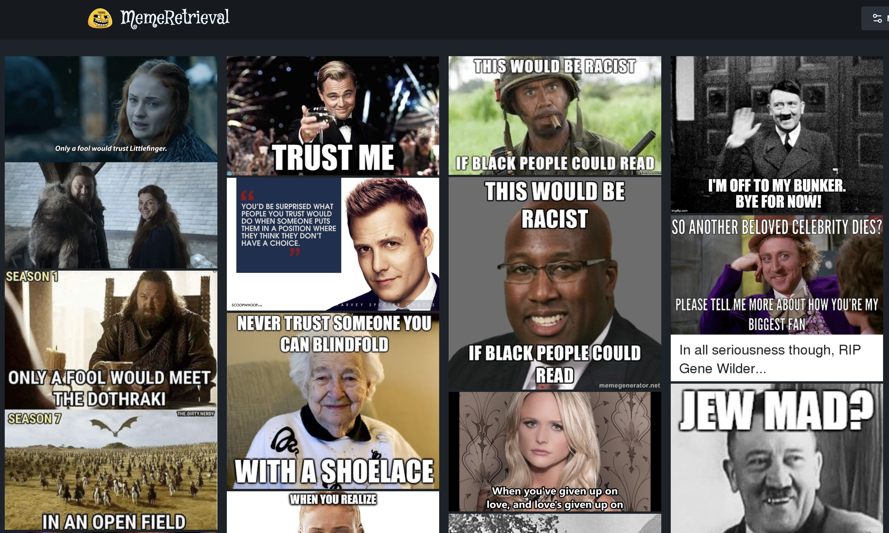


Weighted sum of scores

Slide 38











Use case 2: Image search
Weaviate (no text)
Weaviate (text)

Slide 39
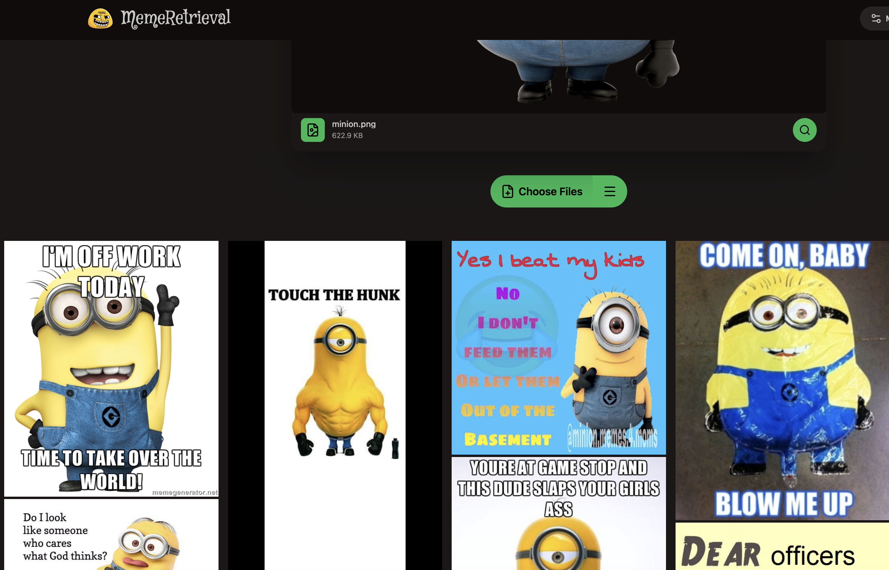

Use case 2: Image search

Slide 40
THANKS FOR LISTENING

